Slide 1
Unit-6, I/O Management and Disk Scheduling

Slide 2
Outline
I/O Devices
Organization of the I/O Function
Operating System Design Issues
I/O Buffering
Disk Scheduling
Notes:
Beginning with a brief discussion of I/O devices and the organization of the I/O functions.
Next examine operating system design issues, including design objectives, and the way in which the I/O function can be structured.
Then I/O buffering is examined;
The next sections of the chapter are devoted to magnetic disk I/O.
We begin by developing a model of disk I/O performance and then examine several techniques that can be used to enhance performance.

Slide 3
1. Categories of I/O Devices
Difficult area of OS design
Difficult to develop a consistent solution due to a wide variety of devices and applications
Three Categories:
Human readable
Machine readable
Communications

Slide 4
1.a Human readable
Devices used to communicate with the user
Printers and terminals
Video display
Keyboard
Mouse etc
Notes:
Suitable for communicating with the computer user.
Examples include printers and terminals, the latter consisting of video display, keyboard, and perhaps other devices such as a mouse.

Slide 5
1.b Machine readable
Used to communicate with electronic equipment
Disk drives
USB keys
Sensors
Controllers
Actuators
Notes:
Suitable for communicating with electronic equipment.
Examples are disk drives, USB keys, sensors, controllers, and actuators.

Slide 6
1.c Communication
Used to communicate with remote devices
Digital line drivers
Modems
I/O controllers
Notes:
Suitable for communicating with remote devices.
Examples are digital line drivers and modems.

Slide 7
2. Differences in I/O Devices
Devices differ in a number of areas
Data Rate
Application
Complexity of Control
Unit of Transfer
Data Representation
Error Conditions
Notes:
Each of these are covered in subsequent slides
This diversity makes a uniform and consistent approach to I/O, both from the point of view of the operating system and from the point of view of user processes, difficult to achieve.

Slide 8
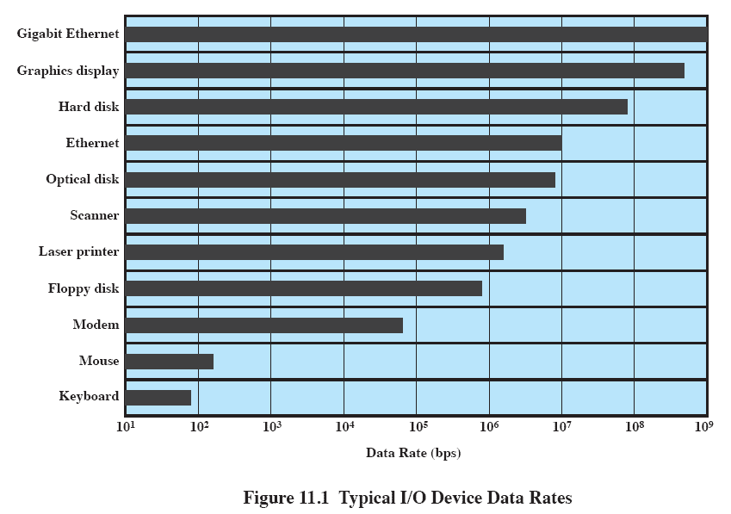
2.A Data Rate
May be massive difference between the data transfer rates of devices
Notes:
There may be differences of several orders of magnitude between the data transfer rates.

Slide 9
2.B Application
Disk used to store files requires file management software
Disk used to store virtual memory pages needs special hardware and software to support it
Terminal used by system administrator may have a higher priority
Notes:
The use to which a device is put has an influence on the software and policies in the operating system and supporting utilities.
Examples:
disk used for files requires the support of file management software.
disk used as a backing store for pages in a virtual memory scheme depends on the use of virtual memory hardware and software.
These applications have an impact on disk scheduling algorithms.
Another example, a terminal may be used by an ordinary user or a system administrator.
implying different privilege levels and perhaps different priorities in the operating system.

Slide 10
2.C Complexity of control
A printer requires a relatively simple control interface.
A disk is much more complex.
This complexity is filtered to some extent by the complexity of the I/O module that controls the device.
Notes:
A printer requires a relatively simple control interface while a disk is much more complex.
This complexity is filtered to some extent by the complexity of the I/O module that controls the device.

Slide 11
2.D Unit of transfer
Data may be transferred as
a stream of bytes or characters (e.g., terminal I/O)
or in larger blocks (e.g., disk I/O).
Notes:
Data may be transferred as a stream of bytes or characters (e.g., terminal I/O) or in larger blocks (e.g., disk I/O).

Slide 12
2.E Data representation
Different data encoding schemes are used by different devices,
including differences in character code and parity conventions.
Notes:
Different data encoding schemes are used by different devices, including differences in character code and parity conventions.

Slide 13
2.F Error Conditions
The nature of errors differ widely from one device to another.
Aspects include:
the way in which they are reported,
their consequences,
the available range of responses
Notes:
The nature of errors, the way in which they are reported, their consequences, and the available range of responses differ widely from one device to another.

Slide 14
Outline
I/O Devices
Organization of the I/O Function
Operating System Design Issues
I/O Buffering
Disk Scheduling

Slide 15
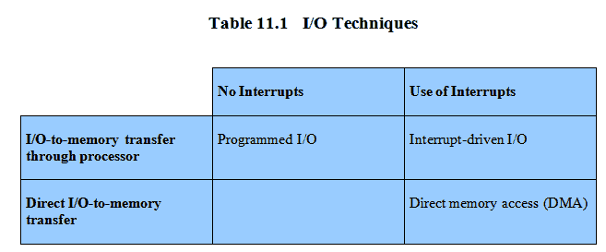
Techniques for performing I/O
Programmed I/O
Interrupt-driven I/O
Direct memory access (DMA)
Notes:
From section 1.7
Programmed I/O:
Processor issues an I/O command, on behalf of a process, to an I/O module;
that process then busy waits for the operation to be completed before proceeding.
Interrupt-driven I/O:
Processor issues an I/O command on behalf of a process.
If the I/O instruction from the process is nonblocking, then the processor continues to execute instructions from the process that issued the I/O command.
If the I/O instruction is blocking, then the next instruction that the processor executes is from the OS, which will put the current process in a blocked state and schedule another process.
Direct memory access (DMA):
A DMA module controls the exchange of data between main memory and an I/O module.
The processor sends a request for the transfer of a block of data to the DMA module and is interrupted only after the entire block has been transferred.
Table 11.1 indicates the relationship among these three techniques.

Slide 16
1. Evolution of the I/O Function
Processor directly controls a peripheral device
Controller or I/O module is added
Processor uses programmed I/O without interrupts
Processor does not need to handle details of external devices
Notes:
The processor directly controls a peripheral device.
This is seen in simple microprocessor-controlled devices.
A controller or I/O module is added.
The processor uses programmed I/O without interrupts.
With this step, the processor becomes somewhat divorced from the specific details of external device interfaces.

Slide 17
Evolution of the I/O Function cont…
Controller or I/O module with interrupts
Efficiency improves as processor does not spend time waiting for an I/O operation to be performed
Direct Memory Access
Blocks of data are moved into memory without involving the processor
Processor involved at beginning and end only
Notes:
3. Now interrupts are employed.
The processor need not spend time waiting for an I/O operation to be performed, thus increasing efficiency.
4. The I/O module is given direct control of memory via DMA.
It can now move a block of data to or from memory without involving the processor, except at the beginning and end of the transfer.

Slide 18
Evolution of the I/O Function cont…
I/O module is a separate processor
CPU directs the I/O processor to execute an I/O program in main memory.
I/O processor
I/O module has its own local memory
Commonly used to control communications with interactive terminals
Notes:
5. I/O module is enhanced to become a separate processor, with a specialized instruction set tailored for I/O.
CPU directs the I/O processor to execute an I/O program in main memory.
The I/O processor fetches and executes these instructions without processor intervention.
Allowing the processor to specify a sequence of I/O activities and to be interrupted only when the entire sequence has been performed.
6. The I/O module has a local memory of its own and is, in fact, a computer in its own right.
A large set of I/O devices can be controlled, with minimal processor involvement.
Commonly used to control communications with interactive terminals. The I/O processor takes care of most of the tasks involved in controlling the terminals.

Slide 19
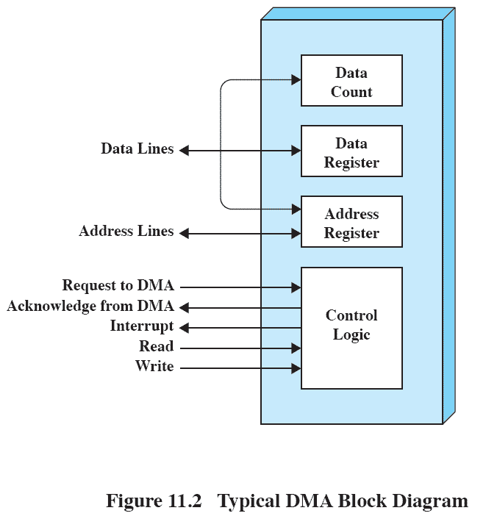
2. Direct Memory Address
Processor delegates I/O operation to the DMA module
DMA module transfers data directly to or form memory
When complete DMA module sends an interrupt signal to the processor

Slide 20
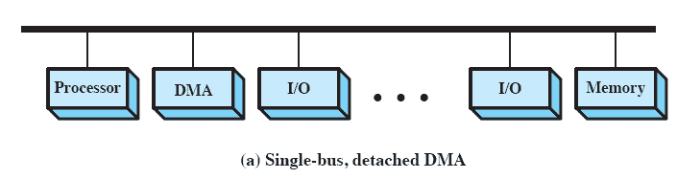
DMA Configurations: Single Bus
DMA can be configured in several ways
Shown here, all modules share the same system bus
Notes:
The DMA mechanism can be configured in a variety of ways.
Some possibilities are shown here In the first example, all modules share the same system bus.
The DMA module, acting as a surrogate processor, uses programmed I/O to exchange data between memory and an I/O module through the DMA module.
This is clearly inefficient: As with processor-controlled programmed I/O, each transfer of a word consumes two bus cycles (transfer request followed by transfer).

Slide 21
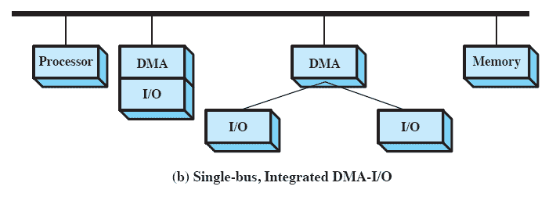
DMA Configurations: Integrated DMA & I/O
Direct Path between DMA and I/O modules
This substantially cuts the required bus cycles
Notes:
The number of required bus cycles can be cut substantially by integrating the DMA and I/O functions.
This means that there is a path between the DMA module and one or more I/O modules that does not include the system bus.
The DMA logic may actually be a part of an I/O module, or it may be a separate module that controls one or more I/O modules.

Slide 22
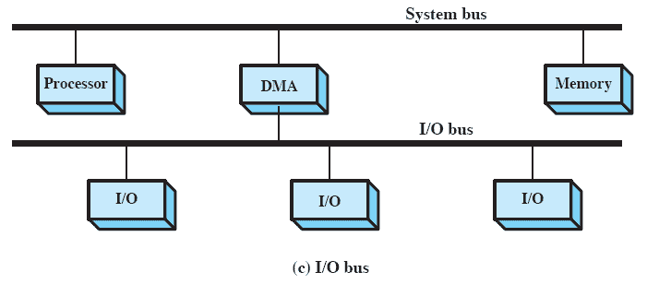
DMA Configurations: I/O Bus
Reduces the number of I/O interfaces in the DMA module
Notes:
This concept can be taken one step further by connecting I/O modules to the DMA module using an I/O bus
This reduces the number of I/O interfaces in the DMA module to one and provides for an easily expandable configuration.
In all of these cases the system bus that the DMA module shares with the processor and main memory is used by the DMA module only to exchange data with memory and to exchange control signals with the processor.
The exchange of data between the DMA and I/O modules takes place off the system bus.

Slide 23
Outline
I/O Devices
Organization of the I/O Function
Operating System Design Issues
I/O Buffering
Disk Scheduling

Slide 24
Goals: Efficiency
Most I/O devices extremely slow compared to main memory
Use of multiprogramming allows for some processes to be waiting on I/O while another process executes
I/O cannot keep up with processor speed
Swapping used to bring in ready processes
But this is an I/O operation itself
Notes:
Efficiency is important because I/O operations often form a bottleneck in a computing system.
One way to tackle this problem is multiprogramming, which, as we have seen, allows some processes to be waiting on I/O operations while another process is executing.
However, even with the vast size of main memory in today’s machines, often I/O is not keeping up with the activities of the processor.
Swapping is used to bring in additional ready processes to keep the processor busy, but this in itself is an I/O operation.
Thus, a major effort in I/O design has been schemes for improving the efficiency of the I/O.
The area that has received the most attention, because of its importance, is disk I/O.

Slide 25
Generality
For simplicity and freedom from error it is desirable to handle all I/O devices in a uniform manner
Hide most of the details of device I/O in lower-level routines
Difficult to completely generalize, but can use a hierarchical modular design of I/O functions
Notes:
For simplicity and freedom from error, it is desirable to handle all devices in a uniform manner.
This applies both to the way in which processes view I/O devices and the way in which the operating system manages I/O devices and operations.
Because of the diversity of device characteristics, it is difficult in practice to achieve true generality.
What can be done is to use a hierarchical, modular approach to the design of the I/O function.
T his hides most of the details of device I/O in lower-level routines so that user processes and upper levels of the operating system see devices in terms of general functions, such as read, write, open, close, lock, unlock.

Slide 26
Hierarchical design
A hierarchical philosophy leads to organizing an OS into layers
Each layer relies on the next lower layer to perform more primitive functions
It provides services to the next higher layer.
Changes in one layer should not require changes in other layers
Notes:
The hierarchical philosophy developed in Chapter 2 suggested that the functions of the operating system should be separated according to their complexity, their characteristic time scale, and their level of abstraction.
This approach leads to an organization of the operating system into a series of layers.
Each layer performs a related subset of the functions required of the operating system.
It relies on the next lower layer to perform more primitive functions and to conceal the details of those functions.
It provides services to the next higher layer.
Ideally, the layers should be defined so that changes in one layer do not require changes in other layers.

Slide 27
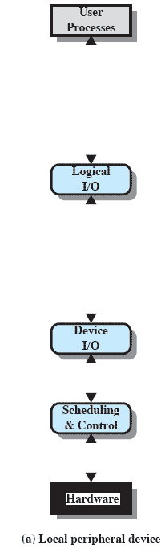
Local peripheral device
Logical I/O:
Deals with the device as a logical resource
Device I/O:
Converts requested operations into sequence of I/O instructions
Scheduling and Control
Performs actual queuing and control operations
Notes:
Logical I/O:
Deals with the device as a logical resource and is not concerned with the details of actually controlling the device.
Concerned with managing general I/O functions on behalf of user processes, allowing them to deal with the device in terms of a device identifier and simple commands such as open, close, read, write.
Device I/O:
The requested operations and data (buffered characters, records, etc.) are converted into appropriate sequences of I/O instructions, channel commands, and controller orders.
Buffering techniques may be used to improve utilization.
Scheduling and control:
The actual queuing and scheduling of I/O operations occurs at this layer, as well as the control of the operations.
Interrupts are handled at this layer and I/O status is collected and reported.
This is the layer of software that actually interacts with the I/O module and hence the device hardware.

Slide 28
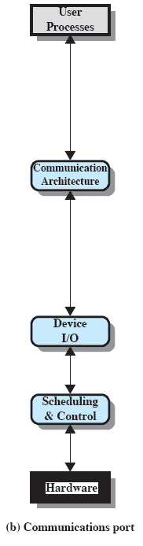
Communications Port
Similar to previous but the logical I/O module is replaced by a communications architecture,
This consist of a number of layers.
An example is TCP/IP,
Notes:
The logical I/O module is replaced by a communications architecture,
which may itself consist of a number of layers.
An example is TCP/IP,.

Slide 29
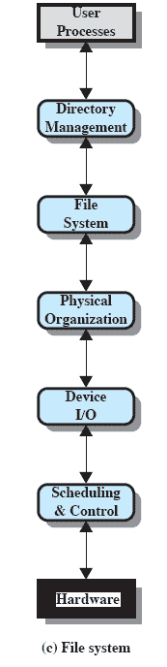
File System
Directory management
Concerned with user operations affecting files
File System
Logical structure and operations
Physical organisation
Converts logical names to physical addresses
Notes:
Directory management:
At this layer, symbolic file names are converted to identifiers that either reference the file directly or indirectly through a file descriptor or index table.
Concerned with user operations that affect the directory of files, such as add, delete, and reorganize.
File system:
This layer deals with the logical structure of files and with the operations that can be specified by users, such as open, close, read, write.
Access rights are also managed at this layer.
Physical organization:
Files and records must be converted to physical secondary storage addresses, taking into account the physical track and sector structure of the secondary storage device.
Allocation of secondary storage space and main storage buffers is generally treated at this layer as well.

Slide 30
Outline
I/O Devices
Organization of the I/O Function
Operating System Design Issues
I/O Buffering
Disk Scheduling
Raid
Disk Cache

Slide 31
I/O Buffering
Processes must wait for I/O to complete before proceeding
To avoid deadlock certain pages must remain in main memory during I/O
It may be more efficient to perform input transfers in advance of requests being made and to perform output transfers some time after the request is made.
Notes:
To avoid deadlock, the user memory involved in the I/O operation must be locked in main memory immediately before the I/O request is issued, even though the I/O operation is queued and may not be executed for some time.
If a block is being transferred from a user process area directly to an I/O module, then the process is blocked during the transfer and the process may not be swapped out.
To avoid these overheads and inefficiencies, it is sometimes convenient to perform input transfers in advance of requests being made and to perform output transfers some time after the request is made.

Slide 32
Block-oriented Buffering
Information is stored in fixed sized blocks
Transfers are made a block at a time
Can reference data b block number
Used for disks and USB keys
Notes:
A block-oriented device stores information in blocks that are usually of fixed size, and transfers are made one block at a time.
Generally, it is possible to reference data by its block number.
Disks and USB keys are examples of block-oriented devices.

Slide 33
Stream-Oriented Buffering
Transfer information as a stream of bytes
Used for terminals, printers, communication ports, mouse and other pointing devices, and most other devices that are not secondary storage
Notes:
A stream-oriented device transfers data in and out as a stream of bytes, with no block structure.
Terminals, printers, communications ports, mouse and other pointing devices, and most other devices that are not secondary storage are stream oriented.

Slide 34
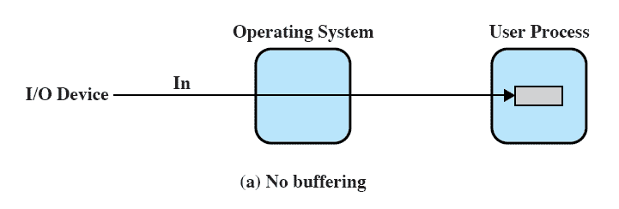
No Buffer
Without a buffer, the OS directly access the device as and when it needs

Slide 35
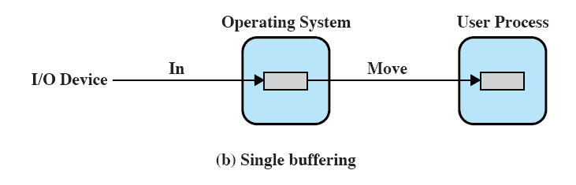
Single Buffer
Operating system assigns a buffer in main memory for an I/O request
Notes:
When a user process issues an I/O request, the operating system assigns a buffer in the system portion of main memory to the operation.

Slide 36
Block Oriented Single Buffer
Input transfers made to buffer
Block moved to user space when needed
The next block is moved into the buffer
Read ahead or Anticipated Input
Often a reasonable assumption as data is usually accessed sequentially
Notes:
For block-oriented devices,
Input transfers are made to the system buffer.
When the transfer is complete, the process moves the block into user space and immediately requests another block.
Called reading ahead, or anticipated input;
it is done in the expectation that the block will eventually be needed.
Often this is a reasonable assumption most of the time because data are usually accessed sequentially.
Only at the end of a sequence of processing will a block be read in unnecessarily.

Slide 37
Stream-oriented Single Buffer
Line-at-time or Byte-at-a-time
Terminals often deal with one line at a time with carriage return signaling the end of the line
Byte-at-a-time suites devices where a single keystroke may be significant
Also sensors and controllers
Notes:
The single buffering scheme can be used in a line-at-a-time fashion or a byte-at-a-time fashion.
Line-at-a-time operation is appropriate for scroll-mode terminals (sometimes called dumb terminals).
Byte-at-a-time operation is used on where each keystroke is significant, or for peripherals such as sensors and controllers.

Slide 38
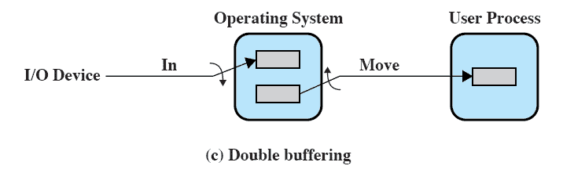
Double Buffer
Use two system buffers instead of one
A process can transfer data to or from one buffer while the operating system empties or fills the other buffer
Notes:
A process transfers data to (or from) one buffer while the operating system empties (or fills) the other.

Slide 39
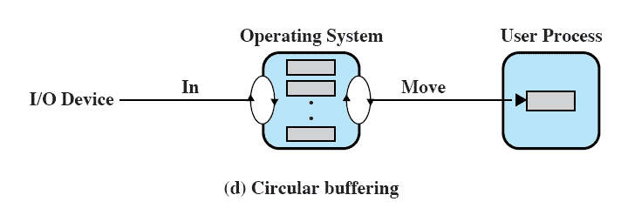
Circular Buffer
More than two buffers are used
Each individual buffer is one unit in a circular buffer
Used when I/O operation must keep up with process
Notes:
Double buffering may be inadequate if the process performs rapid bursts of I/O.
The problem can often be alleviated by using more than two buffers.
When more than two buffers are used, the collection of buffers is itself referred to as a circular buffer with each individual buffer being one
unit in the circular buffer.

Slide 40
Buffer Limitations
Buffering smoothes out peaks in I/O demand.
But with enough demand eventually all buffers become full and their advantage is lost
However, when there is a variety of I/O and process activities to service, buffering can increase the efficiency of the OS and the performance of individual processes.
Notes:
Buffering is a technique that smoothes out peaks in I/O demand.
However, no amount of buffering will allow an I/O device to keep pace with a process indefinitely when the average demand of the process is greater than the I/O device can service.
Even with multiple buffers, all of the buffers will eventually fill up and the process will have to wait after processing each chunk of data.
However, in a multiprogramming environment, when there is a variety of I/O activity and a variety of process activity to service, buffering is one tool that can increase the efficiency of the operating system and the performance of individual processes.

Slide 41
Outline
I/O Devices
Organization of the I/O Function
Operating System Design Issues
I/O Buffering
Disk Scheduling

Slide 42
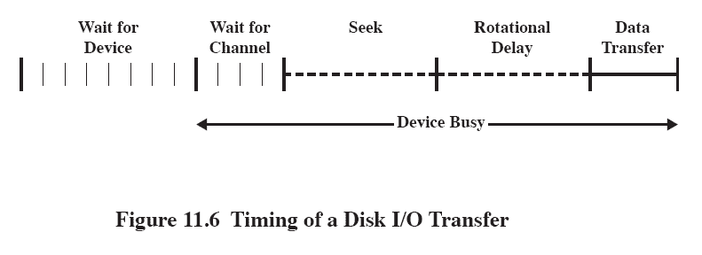
Disk Performance Parameters
The actual details of disk I/O operation depend on many things
A general timing diagram of disk I/O transfer is shown here.
Notes:
The actual details of disk I/O operation depend on the computer system, the operating system, and the nature of the I/O channel and disk controller hardware.
A general timing diagram of disk I/O transfer is shown in Figure 11.6.

Slide 43
Positioning the Read/Write Heads
When the disk drive is operating, the disk is rotating at constant speed.
Track selection involves moving the head in a movable-head system or electronically selecting one head on a fixed-head system.
Notes:
When the disk drive is operating, the disk is rotating at constant speed.
To read or write, the head must be positioned at the desired track and at the beginning of the desired sector on that track.
Track selection involves moving the head in a movable-head system or electronically selecting one head on a fixed-head system.

Slide 44
Disk Performance Parameters
Access Time is the sum of:
Seek time: The time it takes to position the head at the desired track
Rotational delay or rotational latency: The time its takes for the beginning of the sector to reach the head
Transfer Time is the time taken to transfer the data.
Notes:
Access Time is the sum of
Seek Time is the time it takes to position the head at the track.
Rotational delay is the time it takes for the beginning of the sector to reach the head
Once the head is in position, the read or write operation is then performed as the sector moves under the head;
this is the data transfer portion of the operation; the time required for the transfer is the transfer time.

Slide 45
1. Disk Scheduling Policies
To compare various schemes, consider a disk head is initially located at track 100.
assume a disk with 200 tracks and that the disk request queue has random requests in it.
The requested tracks, in the order received by the disk scheduler, are
55, 58, 39, 18, 90, 160, 150, 38, 184.

Slide 46
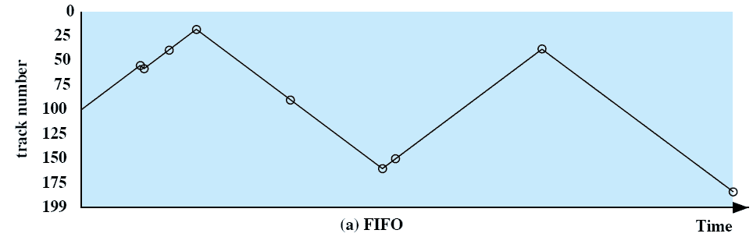
1.A First-in, first-out (FIFO)
Process request sequentially
Fair to all processes
Approaches random scheduling in performance if there are many processes
55, 58, 39, 18, 90, 160, 150, 38, 184.
Notes:
Movie icon jumps to animation at http://gaia.ecs.csus.edu/%7ezhangd/oscal/DiskApplet.html
The simplest form of scheduling is first-in-first-out (FIFO) scheduling, which processes items from the queue in sequential order.
This strategy has the advantage of being fair, because every request is honored and the requests are honored in the order received.
This figure illustrates the disk arm movement with FIFO.
This graph is generated directly from the data in Table 11.2a.
As can be seen, the disk accesses are in the same order as the requests were originally received.
With FIFO, if there are only a few processes that require access and if many of the requests are to clustered file sectors, then we can hope for good performance.
But, this technique will often approximate random scheduling in performance, if there are many processes competing for the disk.

Slide 47
1.B Priority
Goal is not to optimize disk use but to meet other objectives
Short batch jobs may have higher priority
Provide good interactive response time
Longer jobs may have to wait an excessively long time
Notes:
With a system based on priority (PRI), the control of the scheduling is outside the control of disk management software.
This is not intended to optimize disk utilization but to meet other objectives within the operating system.
Often short batch jobs and interactive jobs are given higher priority than longer jobs that require longer computation.
This allows a lot of short jobs to be flushed through the system quickly and may provide good interactive response time.
However, longer jobs may have to wait excessively long times.
Furthermore, such a policy could lead to countermeasures on the part of users, who split their jobs into smaller pieces to beat the system.
This type of policy tends to be poor for database systems.

Slide 48
1.C Last-in, first-out
Good for transaction processing systems
The device is given to the most recent user so there should be little arm movement
Notes:
In transaction processing systems, giving the device to the most recent user should result in little or no arm movement for moving through a sequential file.

Slide 49
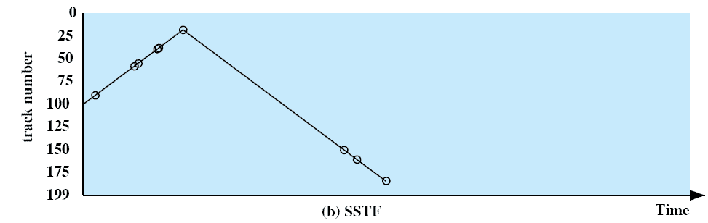
1.D Shortest Service Time First
Select the disk I/O request that requires the least movement of the disk arm from its current position
Always choose the minimum seek time
55, 58, 39, 18, 90, 160, 150, 38, 184.
Notes:
Select the disk I/O request that requires the least movement of the disk arm from its current position.
Thus, we always choose to incur the minimum seek time.
Always choosing the minimum seek time does not guarantee that the average seek time over a number of arm movements will be minimum.
However, this should provide better performance than FIFO.
Because the arm can move in two directions, a random tie-breaking algorithm may be used to resolve cases of equal distances.

Slide 50
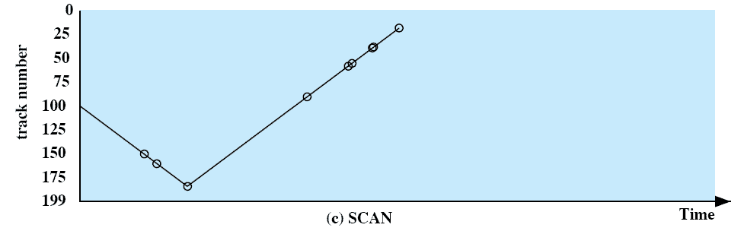
1.E SCAN
Arm moves in one direction only, satisfying all outstanding requests until it reaches the last track in that direction then the direction is reversed
55, 58, 39, 18, 90, 160, 150, 38, 184.
Notes:
With SCAN, the arm is required to move in one direction only, satisfying all outstanding requests en route, until it reaches the last track in that direction or until there are no more requests in that direction.
The service direction is then reversed and the scan proceeds in the opposite direction, again picking up all requests in order.
This latter refinement is sometimes referred to as the LOOK policy.
The SCAN policy favors jobs whose requests are for tracks nearest to both innermost and outermost tracks and favors the latest-arriving jobs.

Slide 51
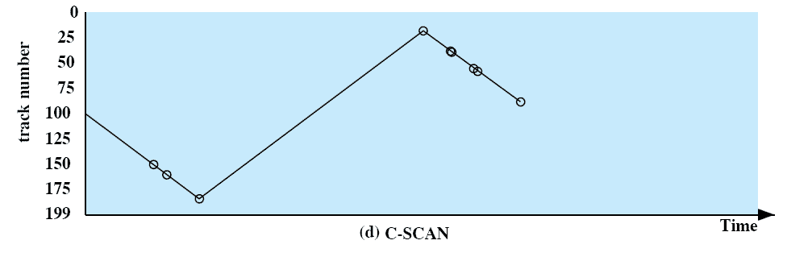
1.F C-SCAN
Restricts scanning to one direction only
When the last track has been visited in one direction, the arm is returned to the opposite end of the disk and the scan begins again
55, 58, 39, 18, 90, 160, 150, 38, 184.
Notes:
The C-SCAN (circular SCAN) policy restricts scanning to one direction only.
Thus, when the last track has been visited in one direction, the arm is returned to the opposite end of the disk and the scan begins again.
This reduces the maximum delay experienced by new requests.

Slide 52
1.G N-step-SCAN
Segments the disk request queue into subqueues of length N
Subqueues are processed one at a time, using SCAN
New requests added to other queue when queue is processed
Notes:
The N-step-SCAN policy segments the disk request queue into subqueues of length N.
Subqueues are processed one at a time, using SCAN.
While a queue is being processed, new requests must be added to some other queue.
If fewer than N requests are available at the end of a scan, then all of them are processed with the next scan.

Slide 53
1.H FSCAN
Two subqueues
When a scan begins, all of the requests are in one of the queues, with the other empty.
All new requests are put into the other queue.
Service of new requests is deferred until all of the old requests have been processed.
Notes:
FSCAN is a policy that uses two subqueues.
When a scan begins, all of the requests are in one of the queues, with the other empty.
During the scan, all new requests are put into the other queue.
Thus, service of new requests is deferred until all of the old requests have been processed.

Slide 54
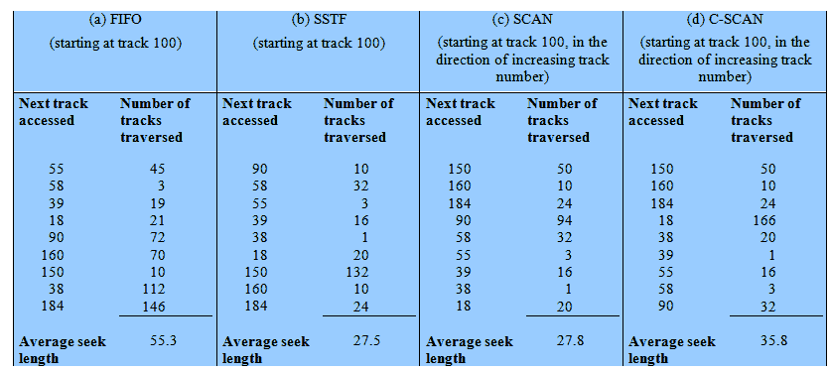
Performance Compared
Comparison of Disk Scheduling Algorithms
Notes:
T

Slide 55
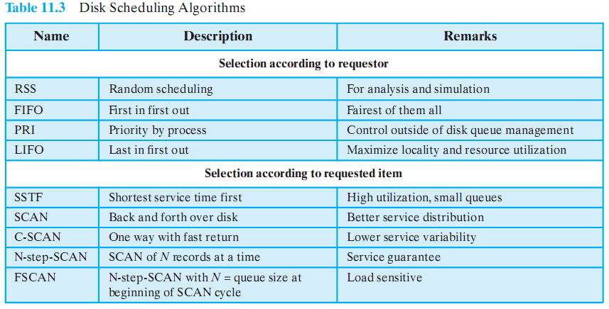
Disk Scheduling Algorithms

